Slide 1
Work & Energy
Chapter 6 (C&J)
Chapter 10(Glencoe)

Slide 2
Energy
What is energy?
  The capacity of a physical system to do work.
What are some forms of energy?
  Kinetic Energy
  Potential Energy
    Gravitational Potential Energy (gravity)
    Elastic Potential Energy (springs, rubber bands)
    Chemical Energy (chemical bonds)
    Rest Mass Energy = Nuclear (E = mc²)
    Electric Potential Energy (ΔU = kq₁q₂/r)
  Thermal Energy (heat = KE of molecules)
  Sound (waves)
  Light (waves/photons)

Slide 3
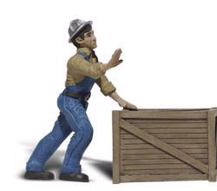
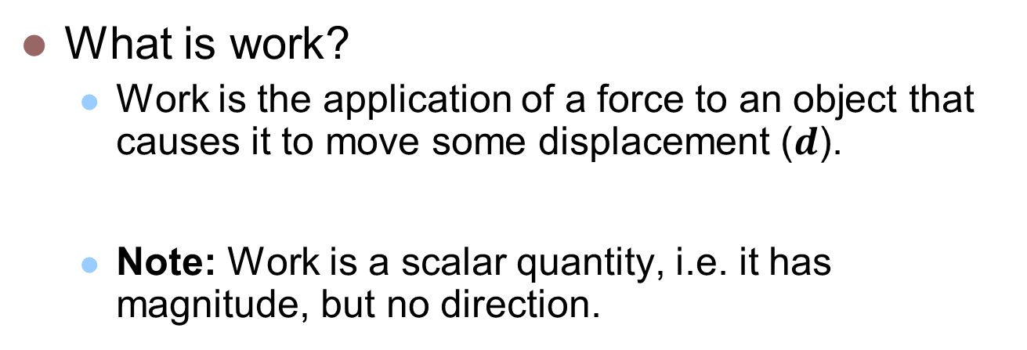


Work
What is work?
  Work is the application of a force to an object that causes it to move some displacement ($d$).
  Note: Work is a scalar quantity, i.e. it has magnitude, but no direction.
$$W=Fd$$
$$F$$
d
If Bob, the warehouse worker pushes the crate with a horizontal force of 50 newtons and causes it to go through a 10 meter displacement, how much work has he done?

Slide 4

Calculating Work
What if the force is not completely in the same direction as the displacement of the object?
F
θ

Slide 5
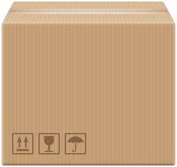


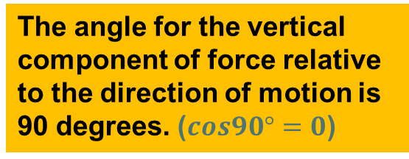


Calculating Work
When all the force is not in the same direction as the displacement of the object, we can use simple trig (Component Vector Resolution) to determine the magnitude of the force in the direction of interest.
Hence:
$$W=Fdcosθ$$
The angle for the vertical component of force relative to the direction of motion is 90 degrees. ($cos90°=0$)
$$F$$
$$Fy=Fsinθ$$
θ
d
$$Fx=Fcosθ$$
NOTE: Only the component of the force that acts in the direction of motion does work on the object.

Slide 6
Example #1:
Little Johnny pulls his loaded wagon 30 meters across a level playground in 1 minute while applying a constant force of 75 Newtons. How much work has he done? The angle between the handle of the wagon and the direction of motion is 40°.
F
θ
d

Slide 7
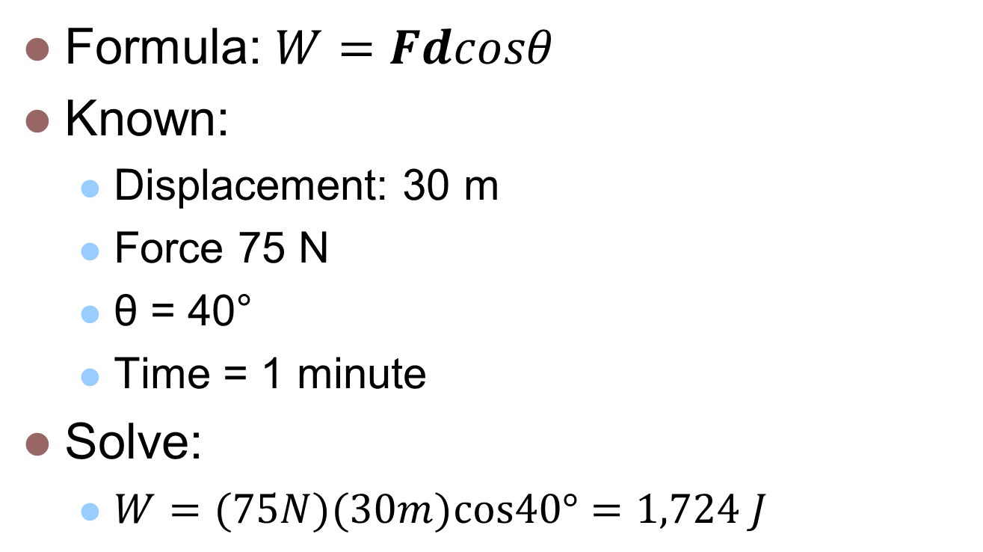
Example #1:
Formula: $W=Fdcosθ$
Known:
  Displacement: 30 m
  Force 75 N
  θ = 40°
  Time = 1 minute
Solve:
  $W=(75N)(30m)cos40°=1,724 J$

Slide 8
Example #2:
The moon revolves around the Earth approximately once every 29.5 days. How much work is done by the gravitational force?
F =
F =
F = 1.99x10²⁰N
In one lunar month, the moon will travel 2πr_{E-m}
  d = 2π(3.84x10⁸m) = 2.41x10⁹m
Gm_{m}m_{E}
r²
(6.67x10⁻¹¹Nm²/kg²)(7.35x10²²kg)(5.98x10²⁴kg)
(3.84x10⁸m)²

Slide 9
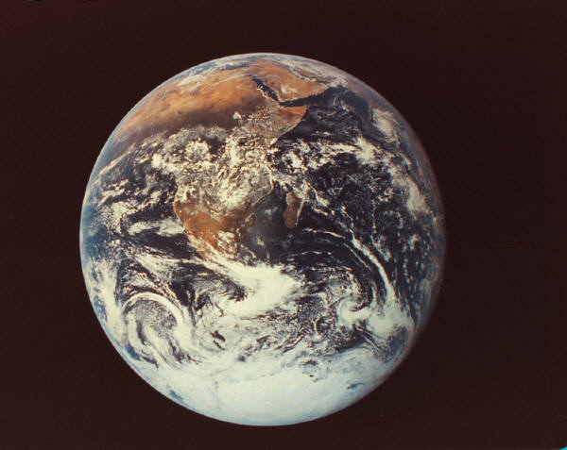
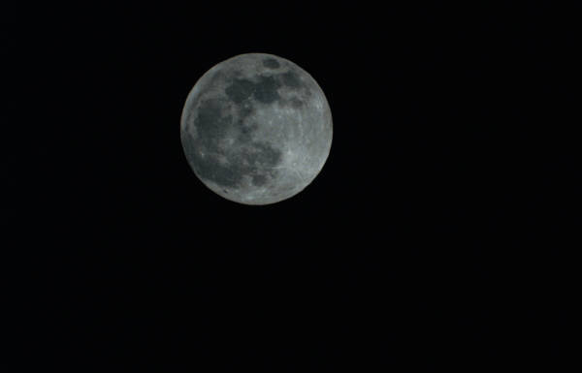
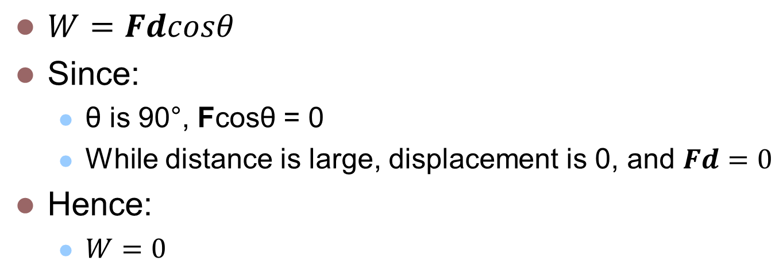
Example #2:
$W=Fdcosθ$
Since:
  θ is 90°, Fcosθ = 0
  While distance is large, displacement is 0, and $Fd=0$
Hence:
  $W=0$
…… HOWEVER!!
d
F

Slide 10
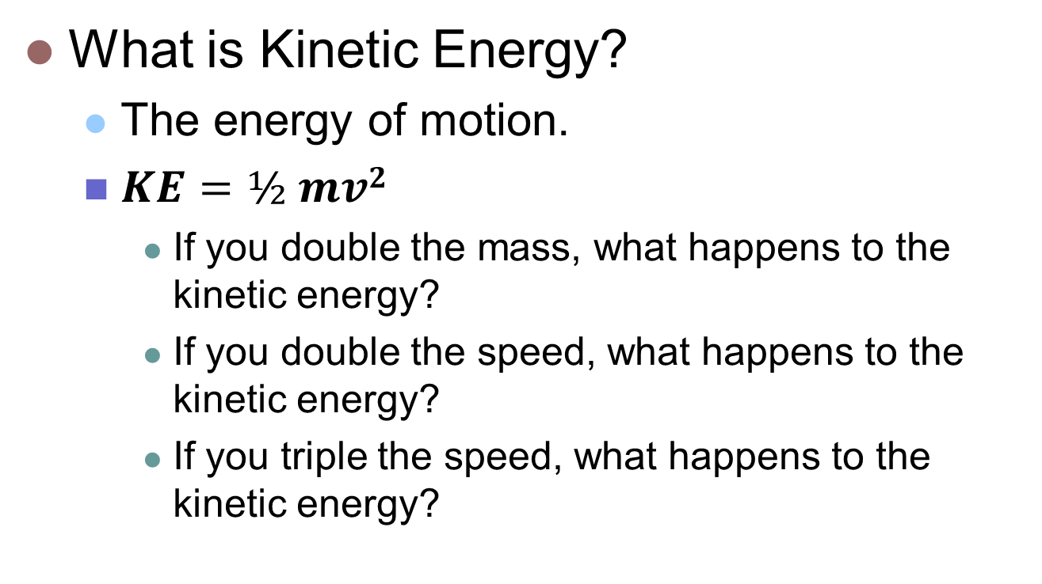
Kinetic Energy
What is Kinetic Energy?
  The energy of motion.
  $KE=½ mv2$
    If you double the mass, what happens to the kinetic energy?
    If you double the speed, what happens to the kinetic energy?
    If you triple the speed, what happens to the kinetic energy?
It doubles.
It quadruples.
It increases by a factor of 9!

Slide 11
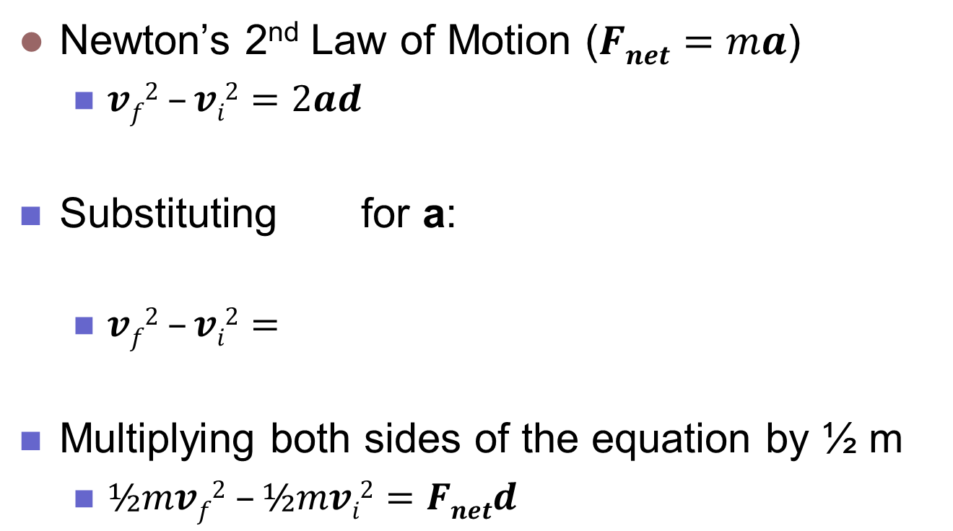

Kinetic Energy & Work
Newton’s 2nd Law of Motion ($Fnet=ma$)
  $vf2 –vi2=2ad$
Substituting for a:
  $vf2 –vi2=$
Multiplying both sides of the equation by ½ m
  $½mvf2 –½mvi2=Fnetd$
$$2 \frac{F_{net}}{m}d$$

Slide 12
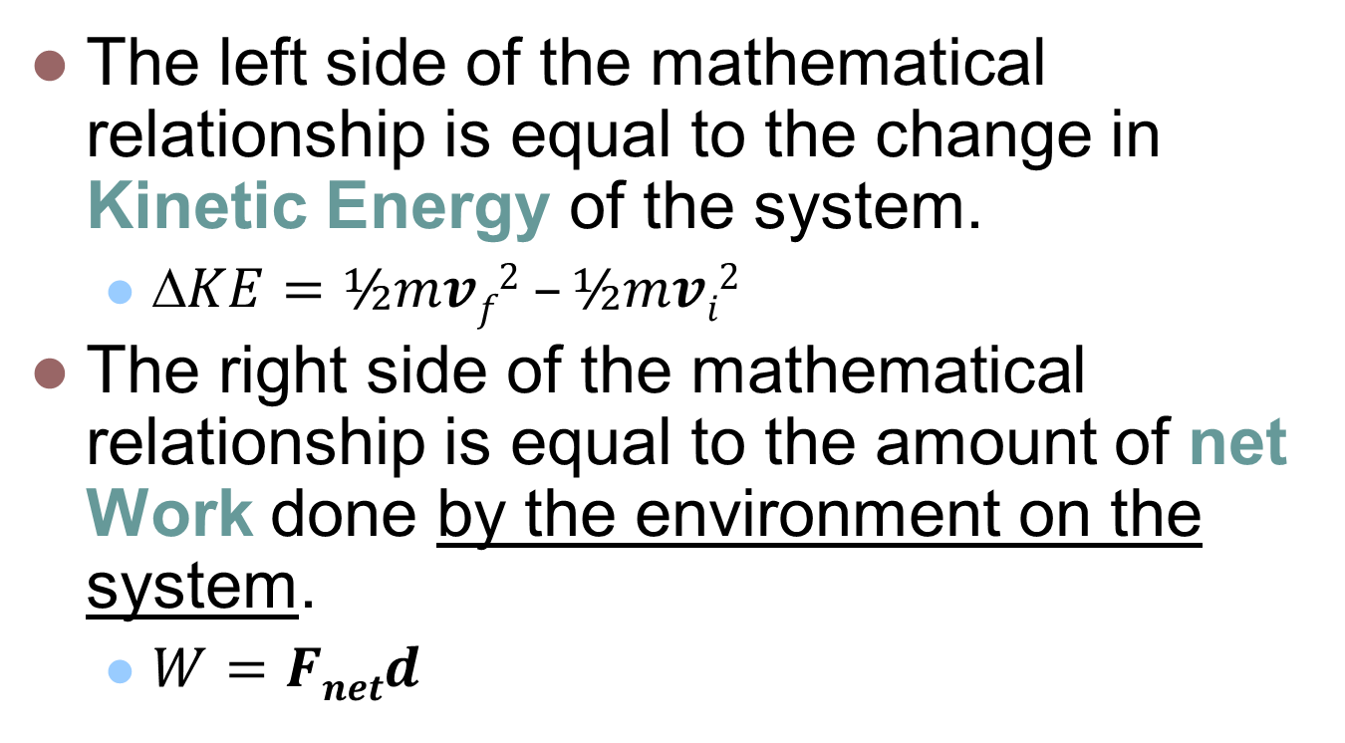
Kinetic Energy & Work
The left side of the mathematical relationship is equal to the change in Kinetic Energy of the system.
  $KE=½mvf2 –½mvi2$
The right side of the mathematical relationship is equal to the amount of net Work done by the environment on the system.
  $W=Fnetd$

Slide 13
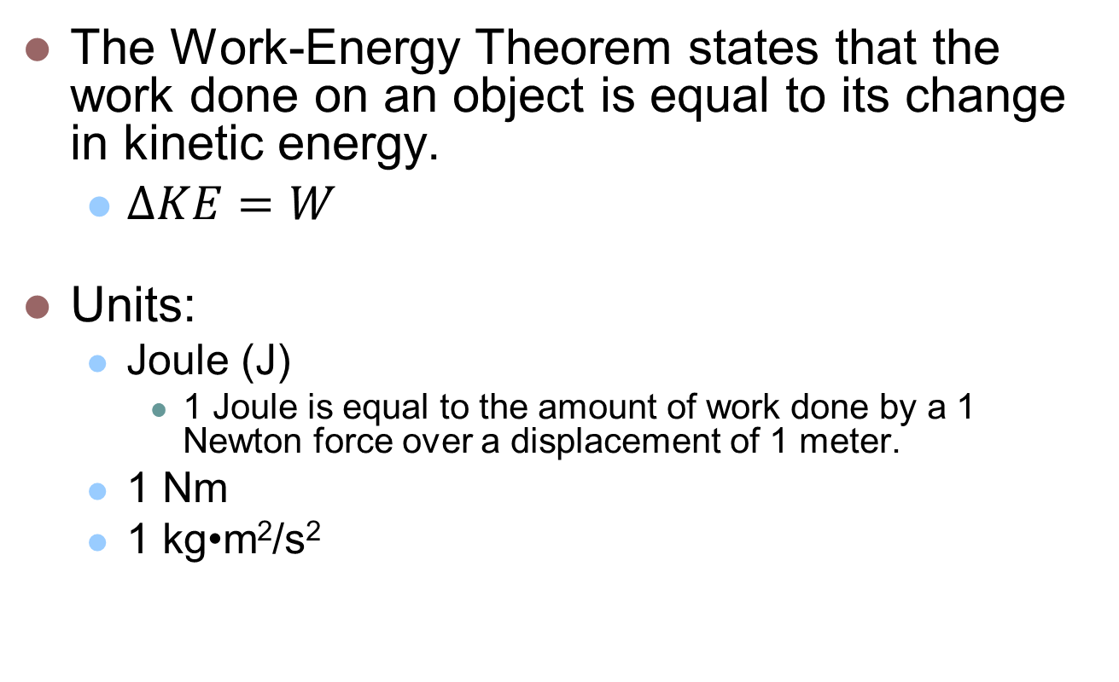
Work – Energy Theorem
The Work-Energy Theorem states that the work done on an object is equal to its change in kinetic energy.
  $ΔKE=W$
Units:
  Joule (J)
    1 Joule is equal to the amount of work done by a 1 Newton force over a displacement of 1 meter.
  1 Nm
  1 kg•m²/s²

Slide 14
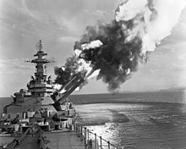
Work-Energy Theorem: Example #3
The Iowa class battleship built during World War II has 9 – 16-inch guns. The length of the gun is 20 meters long. They can fire a 1,900 lb projectile (862 kg). The muzzle velocity (speed at which the projectile leaves the gun) is 1,830 mph, or 820 m/s! That is more than twice the speed of sound!
  How much work was done on the projectile to launch it?
  What was the average net force acting on the projectile?

Slide 15
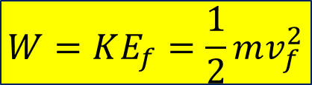
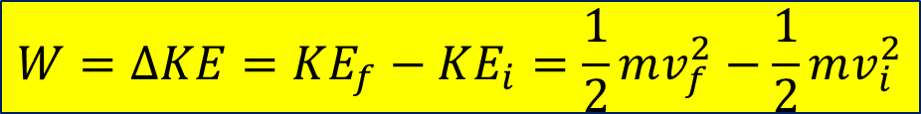

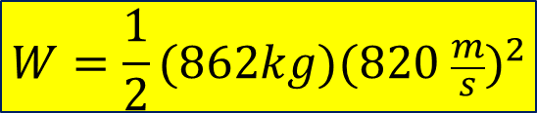
Work-Energy Theorem: Example #3 (Cont.)
How much work was done on the projectile to launch it?
Use the Work-Energy Theorem:
$$W=∆KE=KE_{f}−KE_{i}=\frac{1}{2}mv_{f}^{2}−\frac{1}{2}mv_{i}^{2}$$
Since v_{i} = 0,
$$W=KE_{f}=\frac{1}{2}mv_{f}^{2}$$
$$W=\frac{1}{2}(862kg)({820 \frac{m}{s})}^{2}$$
$$W=2.90×{10}^{8}J$$

Slide 16
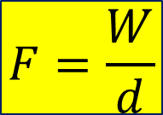


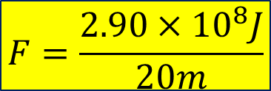
Work-Energy Theorem: Example #3 (Cont.)
What was the average net force acting on the projectile?
$$W=F∙d$$
$$F=\frac{W}{d}$$
$$F=\frac{2.90×{10}^{8}J}{20m}$$
$$W=1.45×{10}^{7}N$$
That’s 3.26 x 10⁶ pounds of force! Or over 1600 tons of force!

Slide 17


Work and Friction: Example #4
The crate below is pushed at a constant speed across the floor through a displacement of 10m with a 50N force.
How much work is done by the worker?
How much work is done by friction?
What is the net work done?
$$Ff$$
$$F$$
d = 10 m

Slide 18
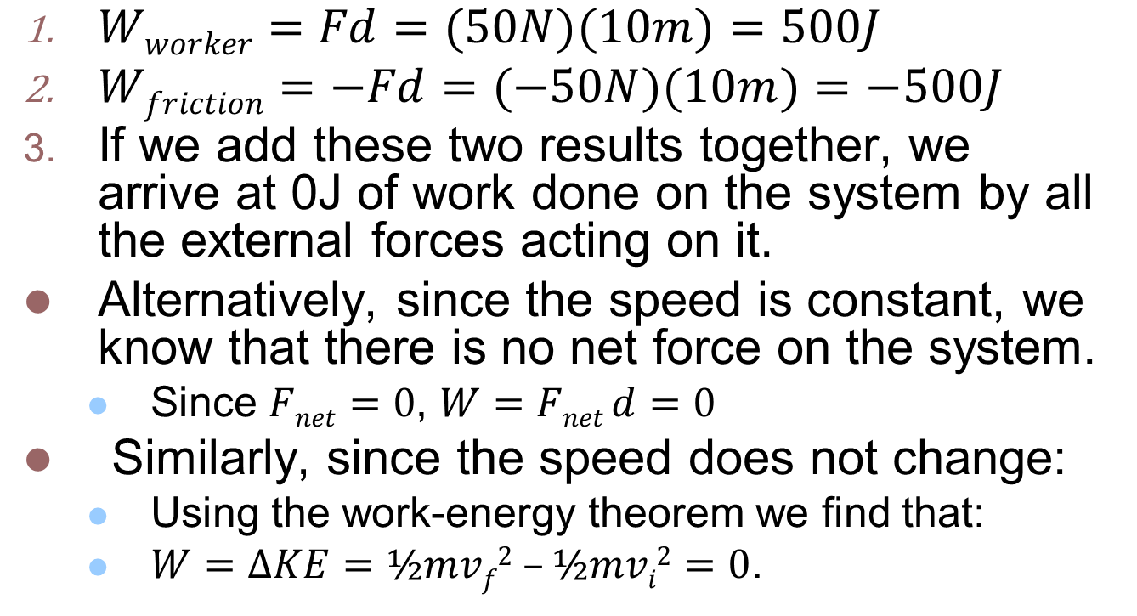
Example #4 (cont.):
$Wworker=Fd=(50N)(10m)=500J$
$Wfriction=−Fd=(−50N)(10m)=−500J$
If we add these two results together, we arrive at 0J of work done on the system by all the external forces acting on it.
Alternatively, since the speed is constant, we know that there is no net force on the system.
  Since $Fnet=0$, $W=Fnet d=0$
Similarly, since the speed does not change:
  Using the work-energy theorem we find that:
  $W=ΔKE=½mvf2 –½mvi2=0$.

Slide 19
Gravitational Potential Energy
If kinetic energy is the energy of motion, what is gravitational potential energy?
  Stored energy with the “potential” to do work as a result of the Earth’s gravitational attraction and the object’s position.
    For example:
      A ball sitting on a table has gravitational potential energy due to its position. When it rolls off the edge, it falls such that its weight provides an unbalanced force over a vertical displacement. Hence, work is done by gravity.

Slide 20


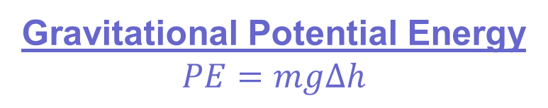
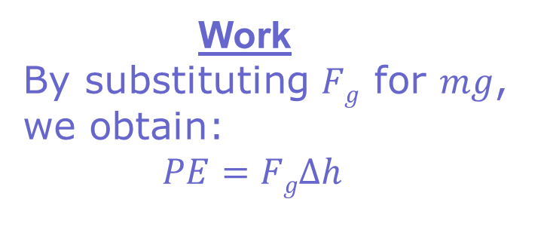
Gravitational Potential Energy
Gravitational Potential Energy
$$PE=mgΔh$$
Work
By substituting $Fg$ for $mg$, we obtain:
$PE=FgΔh$
h
Note: For objects close to the surface of the Earth:
  g is constant.
  Air resistance can be ignored.

Slide 21
Example 5:
A 60 kg skier is at the top of a slope. By the time the skier gets to the lift at the bottom of the slope, she has traveled 100 m in the vertical direction.
  If the gravitational potential energy at the bottom of the hill is zero, what is her gravitational potential energy at the top of the hill?
  If the gravitational potential energy at the top of the hill is set to zero, what is her gravitational potential energy at the bottom of the hill?

Slide 22

Case 1
$$PE=mgΔh$$
$$m=60 kg$$
$$g=9.81\frac{m}{s2}$$
$$h=100 m$$
$$PE=\left(60 kg\right)\left(9.81\frac{m}{s2}\right)\left(100 m\right)$$
$$PE=59000 J$$
$$PE = 59 kJ$$
A
h = 100m
B

Slide 23

Case 2
$$PE=mgΔh$$
$$m=60 kg$$
$$g=9.81\frac{m}{s2}$$
$$h=−100 m$$
$$PE=\left(60 kg\right)\left(9.81\frac{m}{s2}\right)\left(−100 m\right)$$
$$PE=−59000 J$$
$$PE =−59 kJ$$
B
h = 100m
A

Slide 24

Power
What is it?
  Power is measure of the amount of work done per unit of time.
What are the units?
  Joule/second
  Watts
$$P=W/t$$

Slide 25
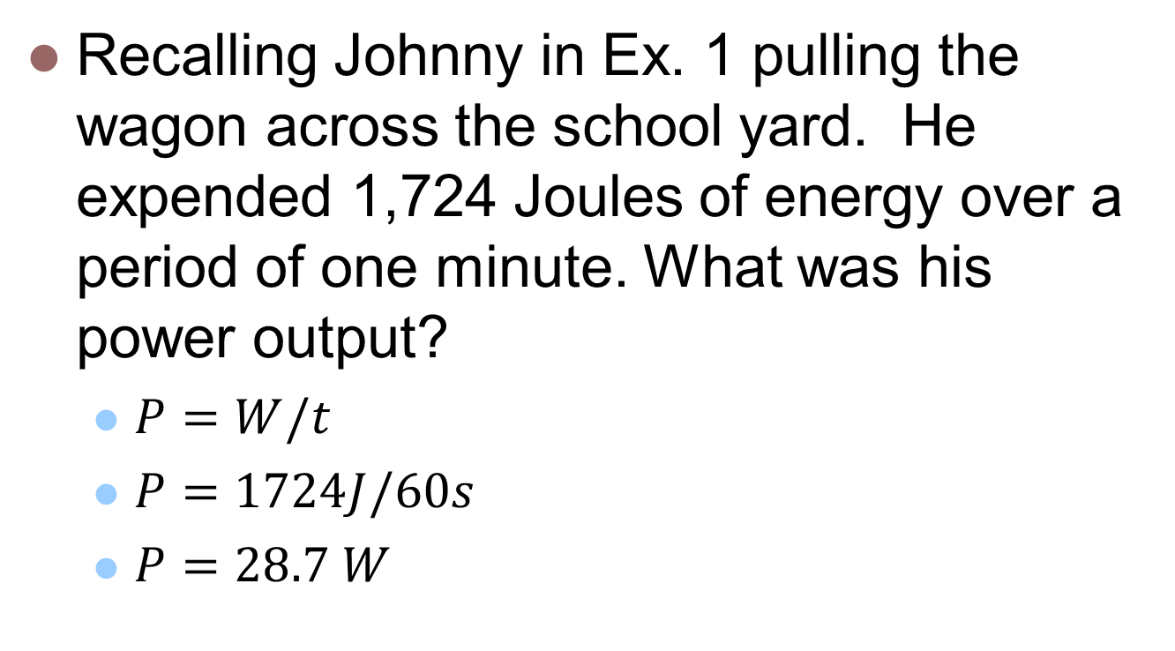
Example 6:
Recalling Johnny in Ex. 1 pulling the wagon across the school yard. He expended 1,724 Joules of energy over a period of one minute. What was his power output?
  $P=W/t$
  $P=1724J/60s$
  $P=28.7 W$

Slide 26
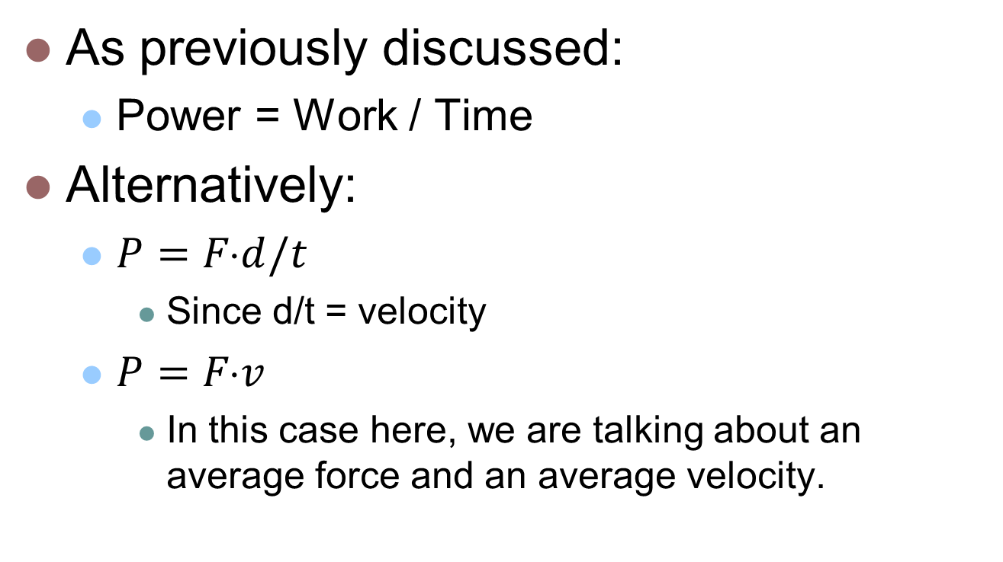
Alternate representations for Power
As previously discussed:
  Power = Work / Time
Alternatively:
  $P=Fd/t$
    Since d/t = velocity
  $P=Fv$
    In this case here, we are talking about an average force and an average velocity.

Slide 27
Example 7:
A corvette has an aerodynamic drag coefficient of 0.33, which translates to about 520 N (117 lbs) of air resistance at 26.8 m/s (60 mph). In addition to this frictional force, the friction due to the tires is about 213.5 N (48 lbs).
  Determine the power output of the vehicle at this speed.

Slide 28
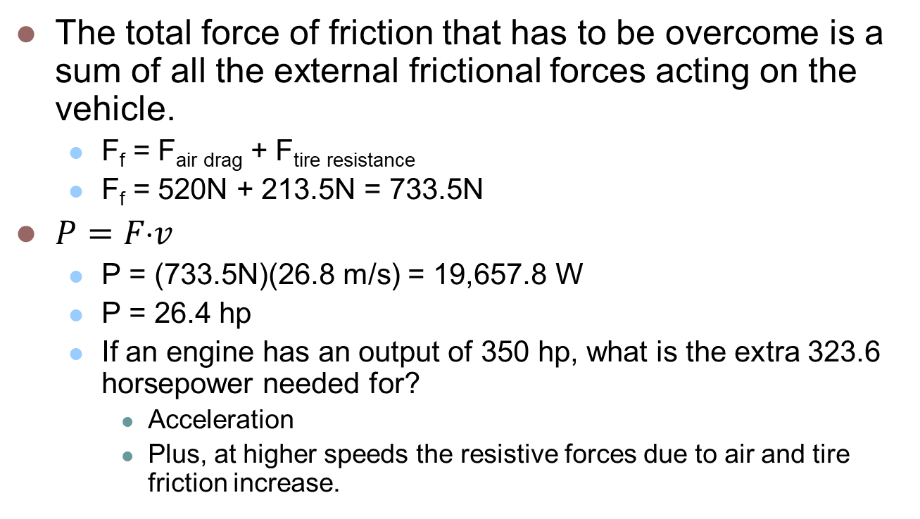
Example 7 (cont.)
The total force of friction that has to be overcome is a sum of all the external frictional forces acting on the vehicle.
  F_{f} = F_{air drag} + F_{tire resistance}
  F_{f} = 520N + 213.5N = 733.5N
$P=Fv$
  P = (733.5N)(26.8 m/s) = 19,657.8 W
  P = 26.4 hp
  If an engine has an output of 350 hp, what is the extra 323.6 horsepower needed for?
    Acceleration
    Plus, at higher speeds the resistive forces due to air and tire friction increase.

Slide 29
Key Ideas
Energy of motion is Kinetic Energy = ½ mv².
Work = The amount of energy required to move an object from one location to another.
The Work-Energy Theorem states that the change in kinetic energy of a system is equal to the amount of work done by the environment on that system.
Power is a measure of the amount of work done per unit of time.

